Slide 1
AUTOMATIC ROOM TEMPERATURE CONTROLLER USING ARDUINO
1
TEAM MEMBERS
SANJIL K C - 20BCE1855
DEVARINTI DHAPATLA PUNEETH REDDY - 20BCE1852
RAJAN SINGH - 20BCE1780

Slide 2


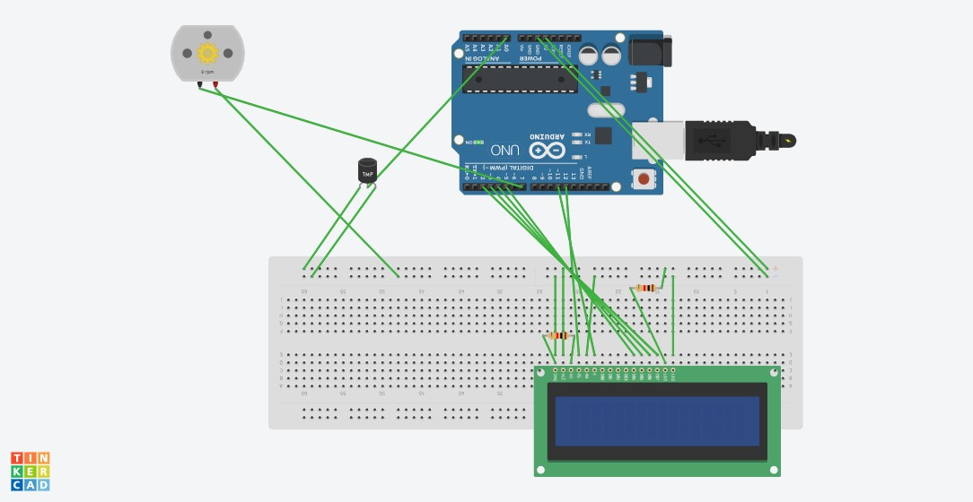

CIRCUIT DIAGRAM

Slide 3
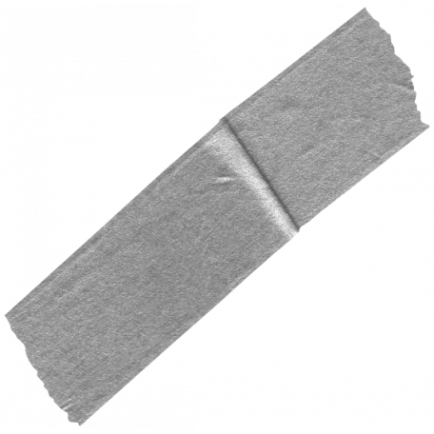

IMPLEMENTATION
Hardware implementation was obtained on Arduino IDE interfaced with P-IV computer. Data flow and block diagram of the hardware implementation are shown in Figs. 1 and 2, respectively. Figures 1 and 2 are simple and self-explanatory where temperature sensors are connected with the help of Arduino and LCD display of 16 2 matrix. The fan was additionally connected for cooling mechanism so that automatic control could be achieved which is main objective of the proposed work. The hardware design is very simple without any circuit complexity (Fig. 3). We used temperature sensor IC LM35 that helps in generating a small voltage for detecting the change in temperature across the temperature sensor.

Slide 4
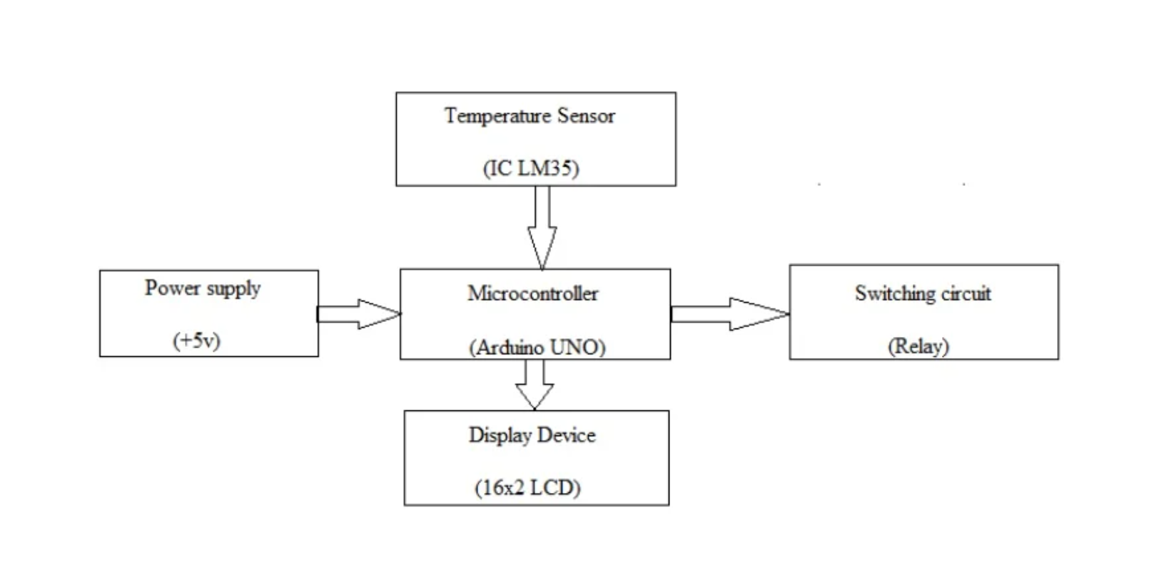

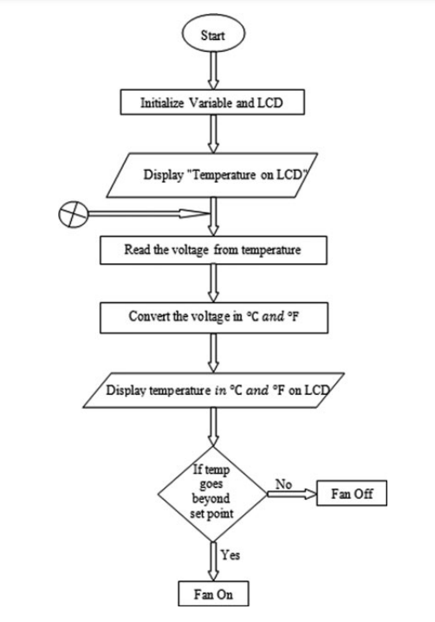



Slide 5
APPLICATION AND WORKING
Application
WORKING
A Temperature Controlled System is a type of control system that automatically controls the temperature of an object or an area.
We commonly use temperature control systems in Air Conditioners, Refrigerators, geysers, modern gadgets and smart homes etc. where the temperature is automatically adjusted as per the input settings. In order to implement a temperature control system, we need a temperature sensor, a controller, and a cooling system.
The program is written in Arduino IDE and facilitates the display of temperature in degree centigrade .The Arduino Uno board facilitates the temperature measurements input to the fan and cooling system ON/OFF that is automatically done based on varied values of temperature.

Slide 6
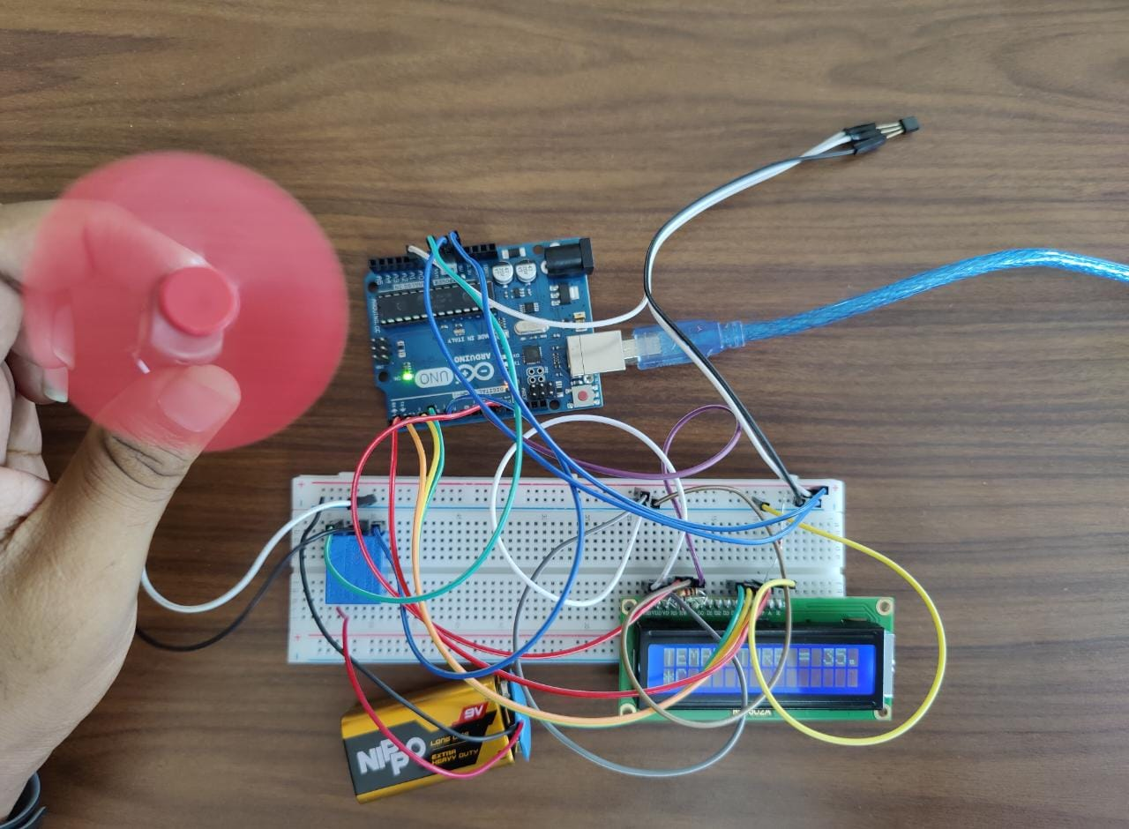

SNAPSHORT OF HARDWARE

Slide 7

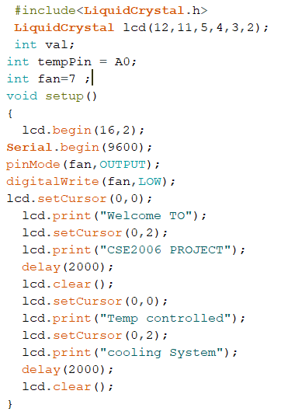
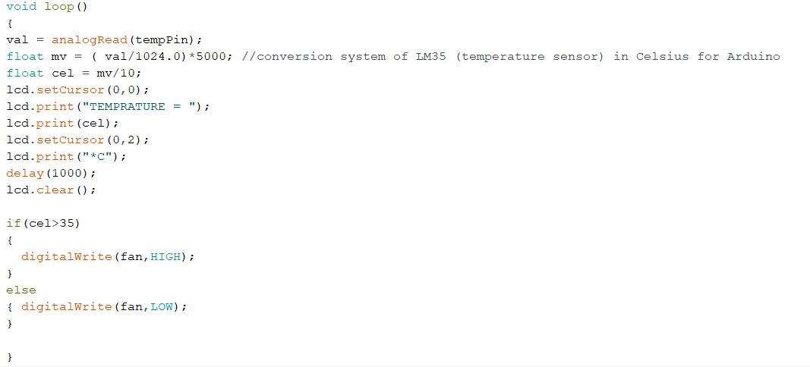
SNAPSHOT OF CODE

